Slide 1
Student Contact Information Virginia Law and FERPA Challenges, Resources and Moving Forward
Communications Network
October 16, 2018

Slide 2
FERPA
Virginia HB1
VCU’s compliance efforts
Impact on communications
Q & A
Today’s Agenda

Slide 3
FerPA and HB1
Bernard Hamm
University Registrar and Director of Records and Registration
Sarah Johns
Associate University Counsel and Assistant Attorney General

Slide 4
Family Educational Rights and Privacy Act (FERPA) (20 U.S.C. § 1232g; 34 CFR Part 99)
Federal law that protects the privacy of student education records. The law applies to all schools that receive funds under an applicable program of the U.S. Department of Education.
go.vcu.edu/ferpa
Schools may disclose, without consent, student "directory" information.
Students, however, may choose to restrict the release of this information – Buckley Hold.
Notes:
Schools must notify parents and eligible students annually of their rights under FERPA. The actual means of notification (special letter, inclusion in a PTA bulletin, student handbook, or newspaper article) is left to the discretion of each school.
I updated bullet 3 to better reflect the Buckley hold.

Slide 5
Important Terms
Eligible Student:
a Student who is 18 or older or who attends a postsecondary institution at any age.
School official with legitimate educational interest:
A VCU employee who needs the information to perform job duties; or
A contractor, consultant, volunteer or other party, who
Performs a VCU service or function
Is under VCU’s direct control as to using and maintaining student records
Will not disclose info to any other party without student’s prior consent and may use info only for the purposes for which the disclosure was made.
Notes:
VCU would otherwise use its own employees
Direct control, e.g. through a legally binding agreement, not general terms and conditions or click-through agreements, such as generally with mass mailing services (MailChimp or Constant Contact) or vendors of textbooks and other classroom materials
I updated line 2 of the second bullet to “perform job duties.”

Slide 6
Protected under FERPA | Directory Information (not protected but student may Opt Out)
Social Security Number Student ID Transcripts Financial Records Gender Race/Ethnicity | Student’s name Date admitted Birthdate Semesters of attendance Major(s) Minor(s) Specialization School Full- or part-time status Classification Degree sought Honors and awards Degree(s) and date(s) received Participation in officially recognized intercollegiate sports and weight, height, hometown, parents’ names and previous school(s) attended (for members of athletic teams) Photograph
Directory information
prior to HB1 included:
Address
Phone number
Email Address
Notes:
I added two bullets to the FERPA protected section, Gender and Race.

Slide 7
FERPA Beyond Directory Information Exception
FERPA generally prohibits disclosing student information without consent unless one of 16 specific exceptions applies.
VCU’s FERPA information page describes regularly used exceptions:
Directory Information
Va. law now restricts use (for address, phone number, email)
Subpoenas and court orders
As necessary in connection with a health or safety emergency
School official with a legitimate educational interest

Slide 8
HB 1(in 2018 Va. General Assembly only) Va. Code § 23.1-405(C) (Permanently)
Student directory information, as defined by FERPA, and which may include a student's name, sex, address, telephone listing, date and place of birth, major field of study, participation in officially recognized activities and sports, weight and height as a member of an athletic team, dates of attendance, degrees and awards received, and other similar information, may be disclosed, provided that the institution has given notice to the student of (i) the types of information that the institution has designated as directory information; (ii) the right of the student to refuse the designation of any or all of the types of information about the student as directory information, and (iii) the period of time within which the student must notify the institution in writing that he does not want any or all of the types of information about the student designated as directory information. However, no institution shall disclose the address, telephone number, or email address of a student pursuant to 34 C.F.R. § 99.31(a)(11) or the Virginia Freedom of Information Act (§ 2.2-3700 et seq.) unless the student has affirmatively consented in writing to such disclosure.
Consistent with FERPA
NEW restriction

Slide 9
Protected under FERPA (may not disclose without consent or exception) | Directory Information (may generally disclose without consent unless student requests privacy – opts out of disclosure) | Protected under HB1 (may not disclose without consent – opt in to disclosure – or exception)
Social Security Number Student ID Transcripts Financial Records Gender Race/Ethnicity | Student’s name Date admitted Birthdate Semesters of attendance Major(s) Minor(s) Specialization School Full- or part-time status Classification Degree sought Honors and awards Degree(s) and date(s) received Participation in officially recognized intercollegiate sports and weight, height, hometown, parents’ names and previous school(s) attended (for members of athletic teams) Photograph | Student’s address Phone number Email Address
Notes:
Added Gender and Race to FERPA protected section.

Slide 10
Interpreting Va. Code § 23.1-405(C)
“[N]o institution shall disclose
the address, telephone number, or email address
of a student
pursuant to [FERPA’s directory information exception or the Virginia FOIA]
unless the student has affirmatively consented in writing to such disclosure.”
Limited Restriction
Prohibits some disclosure
Protects some information (only 3 types)
FERPA’s definition of “student”
Exception for consent

Slide 11
No institution shall disclose the address, telephone number, or email address of a student pursuant to FERPA’s directory information exception or Virginia’s FOIA unless the student has affirmatively consented in writing to such disclosure.
Prohibits some disclosure
By VCU employee or agent to another person (including a student)
Under FERPA’s directory information exception or Va. FOIA
Protects some information
3 types only: address, telephone number, email address
NOT name or other “directory information”
“Student” includes alumni under FERPA
“Is or has been in attendance” at VCU
Contact info collected after graduation is NOT protected education record
VCU-issued student email address still used after graduation is protected
Exception for consent
Consent must specify intended recipients: general public or limited group (students only)
Keep a record of consent

Slide 12
VCU’s Compliance Efforts
Dan Han
Chief Information Security Officer
Jim Yucha
Director of Web Services

Slide 13
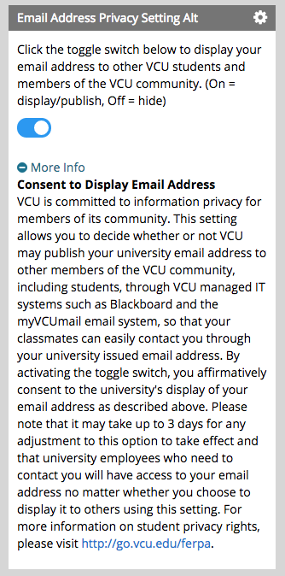
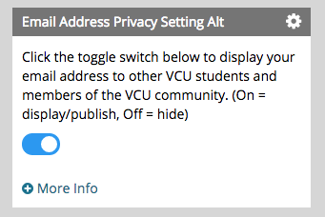
Automated Consent functionality
Toggle switch for consent to disclosures to students
default is off/hide; students can turn consent on or off as they wish
Located in myVCU Portal (Student tab, privacy setting)
Sets field and propagates in multiple systems (Banner, Google)

Slide 14
Tools and Techniques
Obtaining student email addresses
Blackboard class roster
VCU Reporting Center, Faculty Web Reports folder
VCU Technology Services is currently working to provide continued access to any student email address through the VCU employee portal at my.vcu.edu. Faculty members with an @vcu.edu email address can also look up student contact directly from their email by typing in the student’s name.
Email blind copying
Blackboard is automatically configured to blind copy
Student email addresses should be put in the bcc field when using regular email
Consent templates for when a unit needs to craft something for a specific use case, e.g. posting a contact list for students on the web
https://provost.vcu.edu/hb1faq/#general

Slide 15
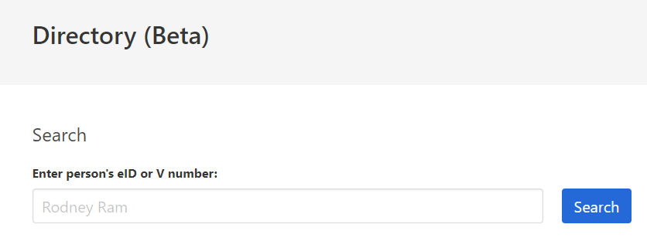
Student Consent Lookup Tool for VCU employees
https://directory.vcu.edu
VERSION 1 – enhancements to come
Available to employees, faculty, graduate assistants and student workers
CAS protected
Search order (prioritization) is checking
If you search by name, it must be an exact match.
"Jim Yucha" will not work -- real name is "James Yucha".
eID | 2. Full name | 3. V number
"Directory Content Options" https://directory.vcu.edu/consent-options
"What is this?" will display this information.

Slide 16
Impact on Communications
Mike Porter
Associate Vice President for Public Affairs
Raina Fields
Director of Internal Communications
Connie Whetstine
Director, Collaboration Services

Slide 17
Notifications to date
May/June
Notified Web User Group to remove student contact information from school and department webpages
August/September
Reminder email with updated information re: webpage (added information that was specific to T&R faculty).
TelegRam announcement for Faculty/Staff (8-27 and 9-4)
Planned (Oct./Nov.)
Emails to faculty, staff and students regarding removal of student contact information from phonebook.vcu.edu and VCU People Search
Launched HB1 FAQs web page to which all communications linked.
Reminders placed on VCU People search and Axis TV
TelegRam announcement encouraging students to opt-in via eServices (8-27 and 9-4)
Another push for students to opt-in
Message to faculty and staff re: Student Consent eID
TelegRam affirmative consent form
Specific recommendations to communications directors/development officers on the use of third-party email platforms.

Slide 18
FAQs
go.vcu.edu/hb1
Compiled from a variety of questions from faculty, staff and students.
Quick Tips for Fall 2018

Slide 19
Most common question: Can we use a third-party email service (such as MailChimp or Constant Contact) to send information to students?
Short answer: No
Longer answer: VCU may disclose student information to a third party contractor as a “school official” if VCU has delegated a university function to the contractor, which would otherwise be performed by a VCU employee, and VCU maintains control over the contractor’s use and disclosure of the information. VCU employees using third-party resources should confirm that VCU’s relationship with the contractor satisfies FERPA’s “school official” exception or seek student consent.

Slide 20
For Reference
Sample contract term designating contractor as school official
To the extent that University provides to Company any identifiable student information, including student address, phone number and email address, the University hereby designates Company as a school official with a legitimate educational interest in using such student information, and Company agrees to use such information only for the purpose of fulfilling its obligations under this Agreement and further agrees not to disclose any such student information to any individual other than the student except as required by law or authorized in writing by the University or the individual student.

Slide 21
If you currently use a third-party email service
There are options:
Google Groups
Listserv
Maestro
Contact Collaboration Services (drgee@vcu.edu)

Slide 22
Questions

Slide 23
Additional Questions?
Quick Tips and FAQ, go.vcu.edu/hb1

